Slide 1

Security in Multi-tier Systems (part 01)
Trust
HTTPS handshake
Certificates
Encryption
[ CS 308 / 350 / 354 ]

Slide 2
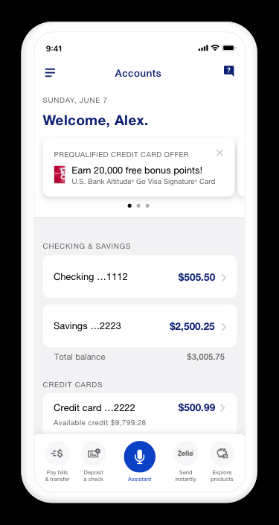


Trust
How do you know you are communicating with the right server? And how do we know the communication is private and secure?
2

Slide 3
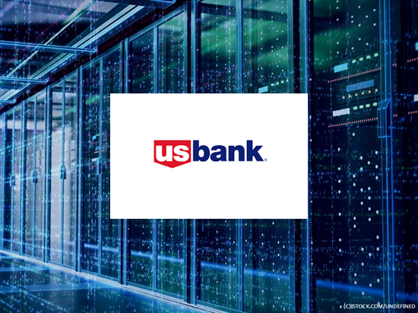
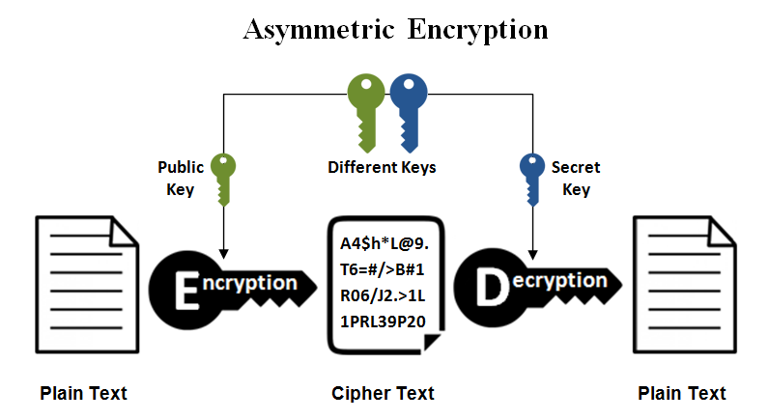
Public/private key encryption
Encryption is performed using a pair of keys
If we have US Bank's public key, we can encrypt and send them a message --- and only they can decrypt it because only they have the matching private key
3

Slide 4

Public/private key encryption
Encryption is performed using a pair of keys
If we have US Bank's public key, we can encrypt and send them a message --- and only they can decrypt it because only they have the matching private key
4

Slide 5
Proof of identity
Also --- if we have US Bank's public key and successfully decrypt their message, we know it's from US Bank because only they have the private key
5

Slide 6

Proof of identity
Also --- if we have US Bank's public key and successfully decrypt their message, we know it's from US Bank because only they have the private key
6

Slide 7
HTTPS "handshake"
HTTPS is designed to prove identity *and* encrypt by securely getting public key to the client
Notes:
For simplicity omitting some details, but this is the overall idea. Take a security class for more details ☺
On Windows, run "CertMgr" to view local certificate storage

Slide 8






HTTPS "handshake"
HTTPS is designed to prove identity *and* encrypt
Notes:
For simplicity omitting some details, but this is the overall idea. Take a security class for more details ☺

Slide 9
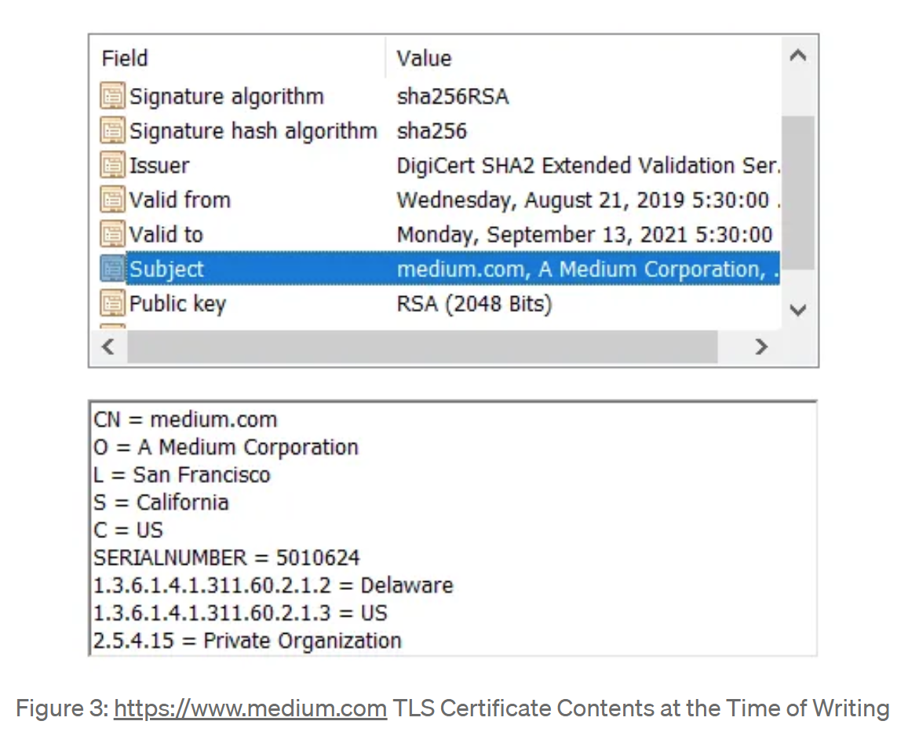
Example: SSL / TLS certificate
https://medium.com/demystifying-security/understanding-tls-certificates-76bdd5815d95

Slide 10
Asymmetric encryption
Public/private key encryption is an example of asymmetric encryption
Different keys to encrypt vs. decrypt
Advantage?
The private key is never shared / transmitted
10

Slide 11
Bi-directional
Both parties can encrypt and decrypt
Client encrypts with public, server decrypts with private
Server encrypts with private, client decrypts with public
11

Slide 12
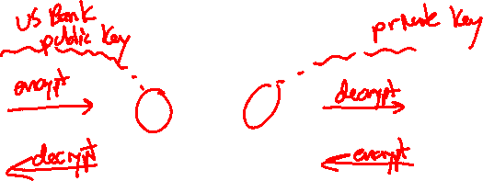
Bi-directional
Both parties can encrypt and decrypt
Client encrypts with public, server decrypts with private
Server encrypts with private, client decrypts with public
12

Slide 13
Beware!
It's bi-directional, but…
Encryption only guarantees privacy in one direction
Trust is only established in one direction
13

Slide 14
Example
Client has US Bank's public key
Server (US Bank) has its private key
14

Slide 15
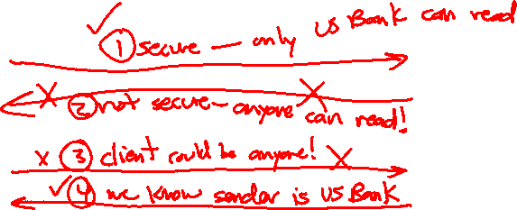
Example
Client has US Bank's public key
Server (US Bank) has its private key
15

Slide 16
Full security in both directions?
Two options:
You need 2 pairs of public/private keys, with each party having public key of the other
Use a symmetric key (next slide)
16

Slide 17
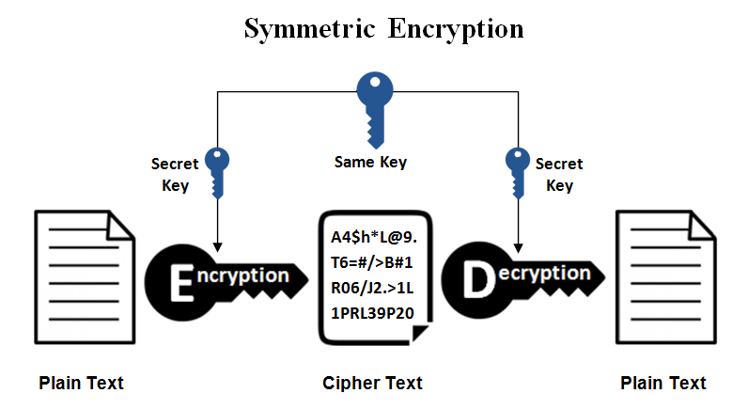
Symmetric encryption
After HTTPS handshake, client and server exchange a single key for faster symmetric encryption
Single key can be used by both parties to encrypt & decrypt
17

Slide 18
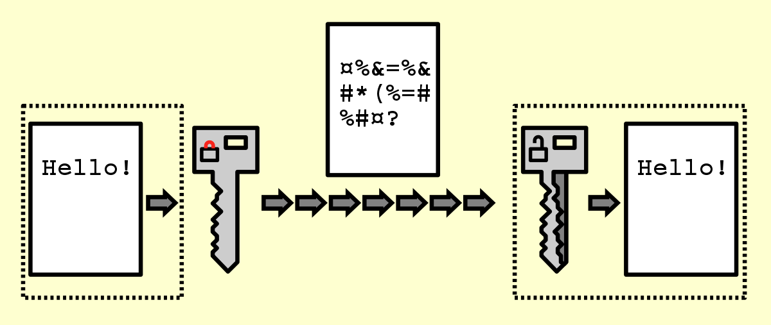











Symmetric encryption
After HTTPS handshake, client and server exchange a single key for faster symmetric encryption
18

Slide 19
SSL / TLS certificates
The good news?
Easy to obtain, sign, and register certificate so you can secure your app
https://docs.aws.amazon.com/acm/latest/userguide/gs-acm-request-public.html
https://www.verisign.com/en_US/website-presence/online/ssl-certificates/index.xhtml
SSL = secure sockets layer (deprecated)
TLS = transport layer security (new std)
19
Notes:
SSL = secure sockets layer (deprecated)
TLS = transport layer security (new std)

Slide 20
That's it, thank you!

